Slide 1



Building a Quantum Engineering Undergraduate Program
Lincoln D. Carr
Quantum Engineering Program
and Department of Physics,
Colorado School of Mines, Golden, Colorado, USA
Representing 37 authors from across academia, industry, and national labs
Based on verbal and written feedback from ~500 quantum contributors to NSF Workshop on Quantum Engineering Education

Slide 2
Outline: Building a Quantum Engineering Undergraduate Program
What is a “quantum engineer?”
The quantum aware engineer
Quantum 101
The quantum proficient engineer
Promoting diversity in quantum engineering
Hands-on training on quantum hardware
Key recommendations

Slide 3
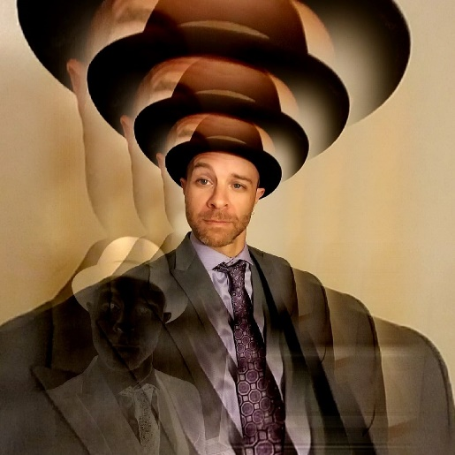


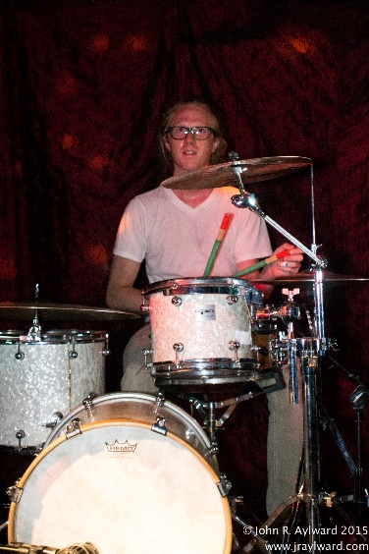


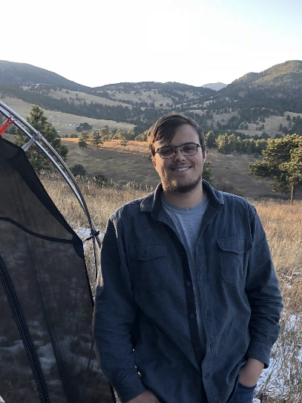

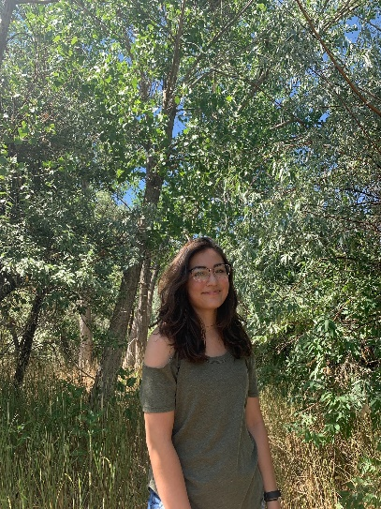
Carr Group at the Colorado School of Mines:
Quantum Engineering, Physics, Applied Mathematics
→ Complexity Science
Mina Fasihi,
PhD Physics
Seth Grable,
PhD Physics
Matt Jones,
PhD Physics
Joel Been, MS Applied Mathematics
Khloe Downie
MS Applied Physics
Josh Lewis, MS Quantum Engineering
Benjamin Krawciw, BS Engineering Physics
Maya Vazquez,
BS Engineering Physics

Slide 4
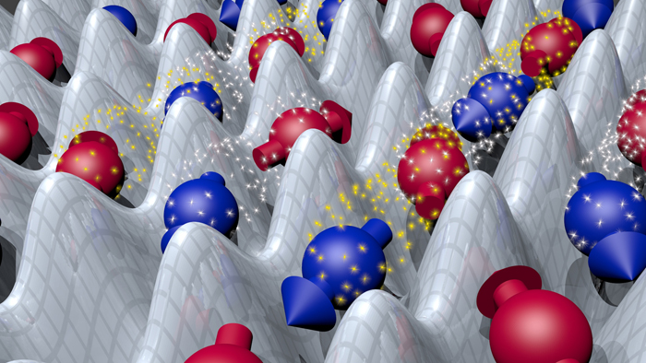
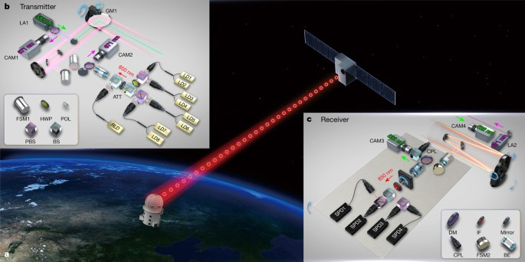
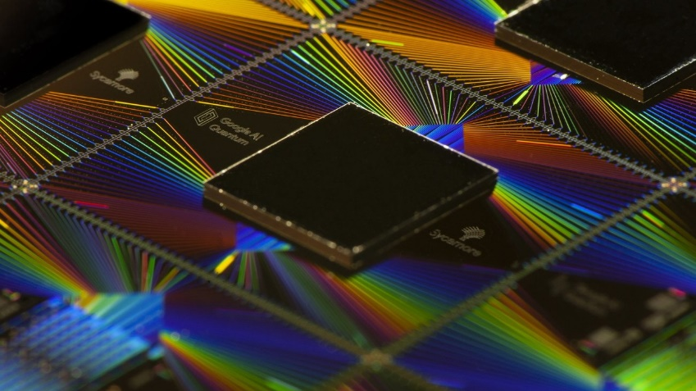
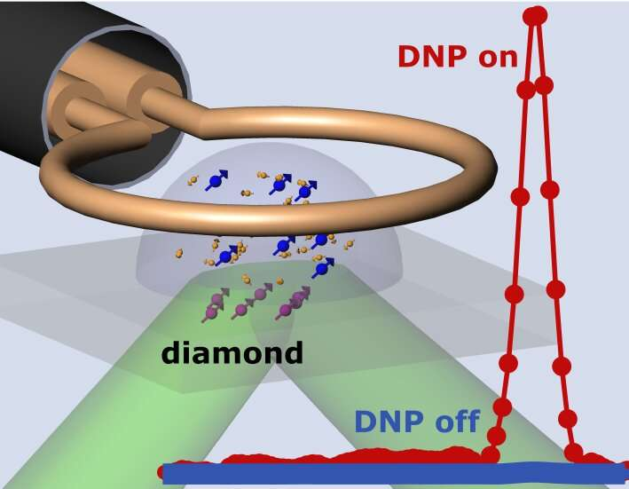
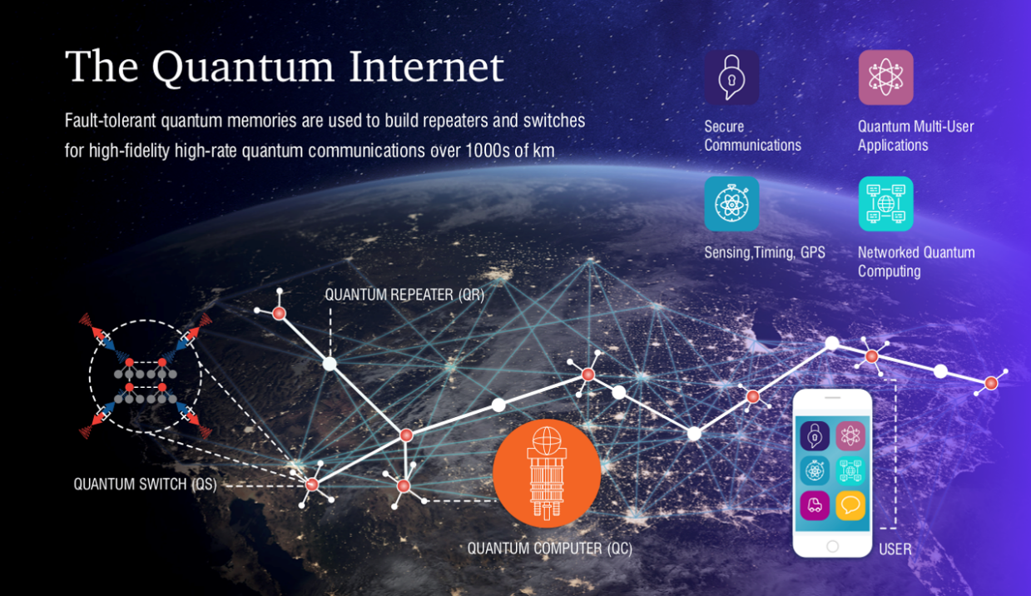
Quantum Information Technology
Quantum simulation
  ETH Zurich, 2013
Quantum cryptography
  Nature 2017 Micius satellite, China
Quantum computing
  Google Quantum AI, USA, 2019
Quantum sensing
  Harvard/Maryland 2020
Quantum networking
  NSF Engineering Research Center based at U. Arizona
Notes:
New version of quantum NMR allows access to picoliter scale
DNP – dynamic nuclear polarization

Slide 5
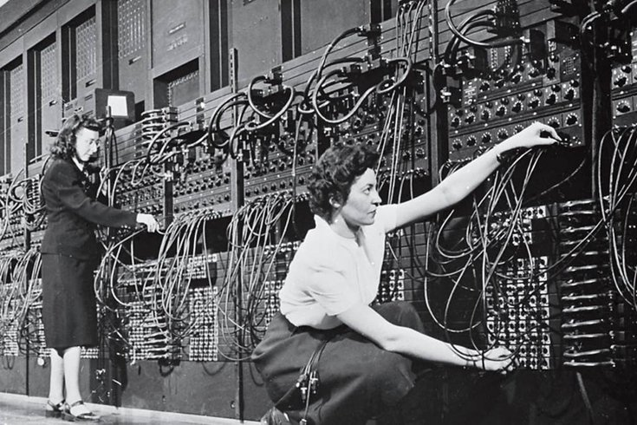
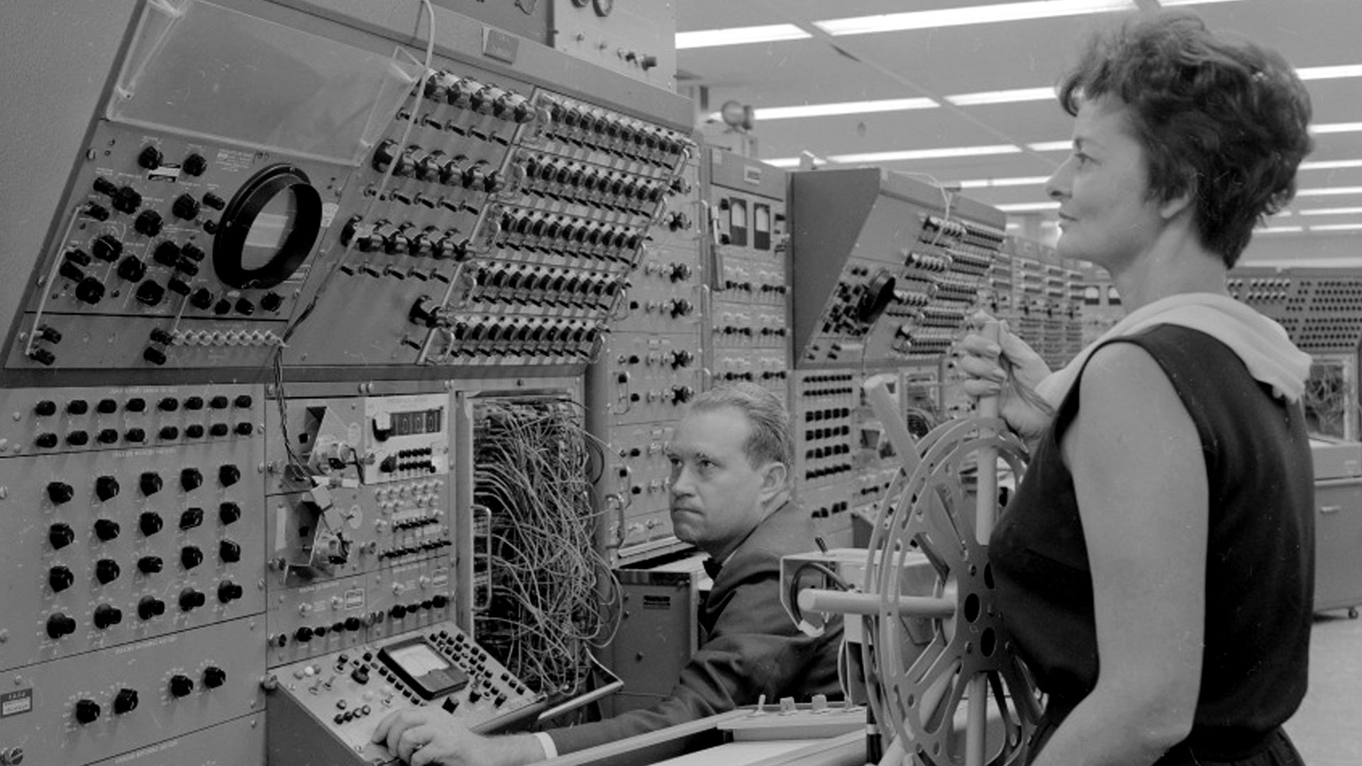
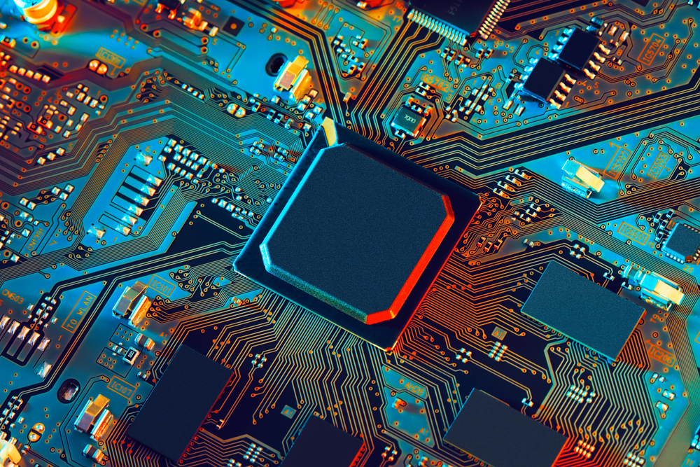
Where do Engineers fit in? Recall:
Eniac 1945
Analog steering system, 1966
ASIC chip, Linear Microsystems, 2020
Notes:
Research Engineer Mrs. T. Vasquez at Analog Computer (1966)
Application-Specific Integrated Circuit

Slide 6
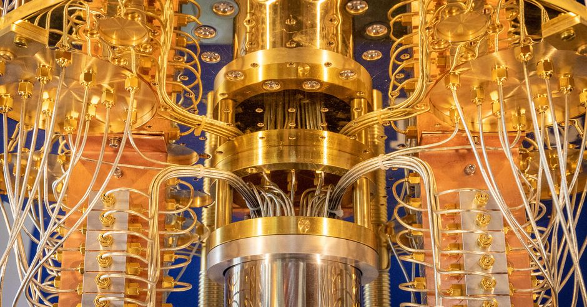
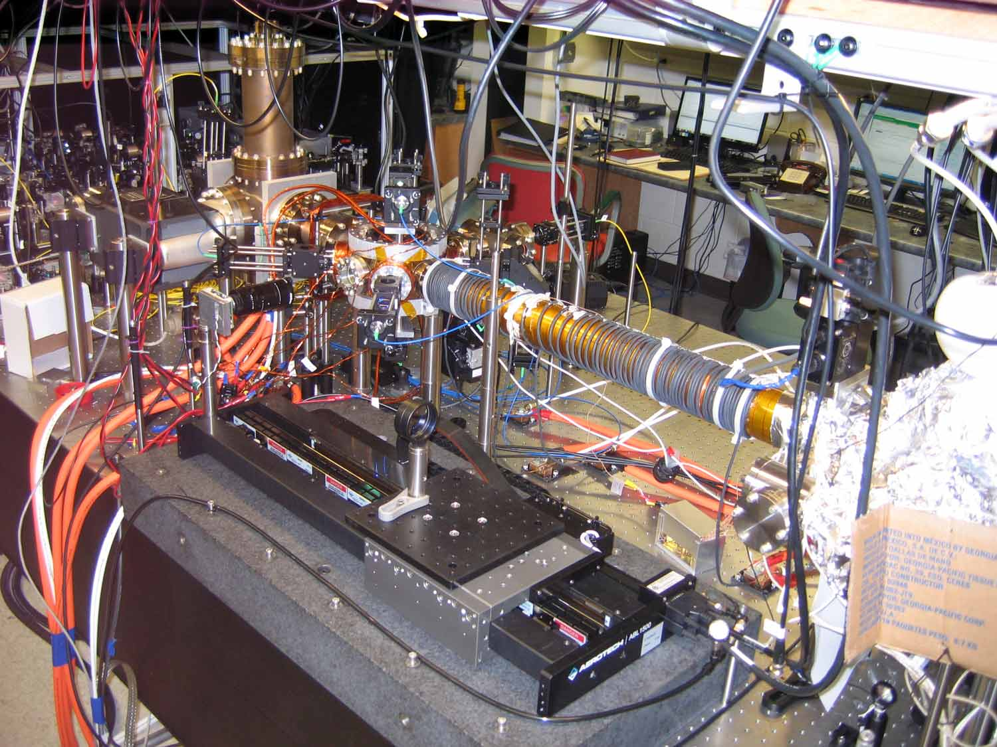
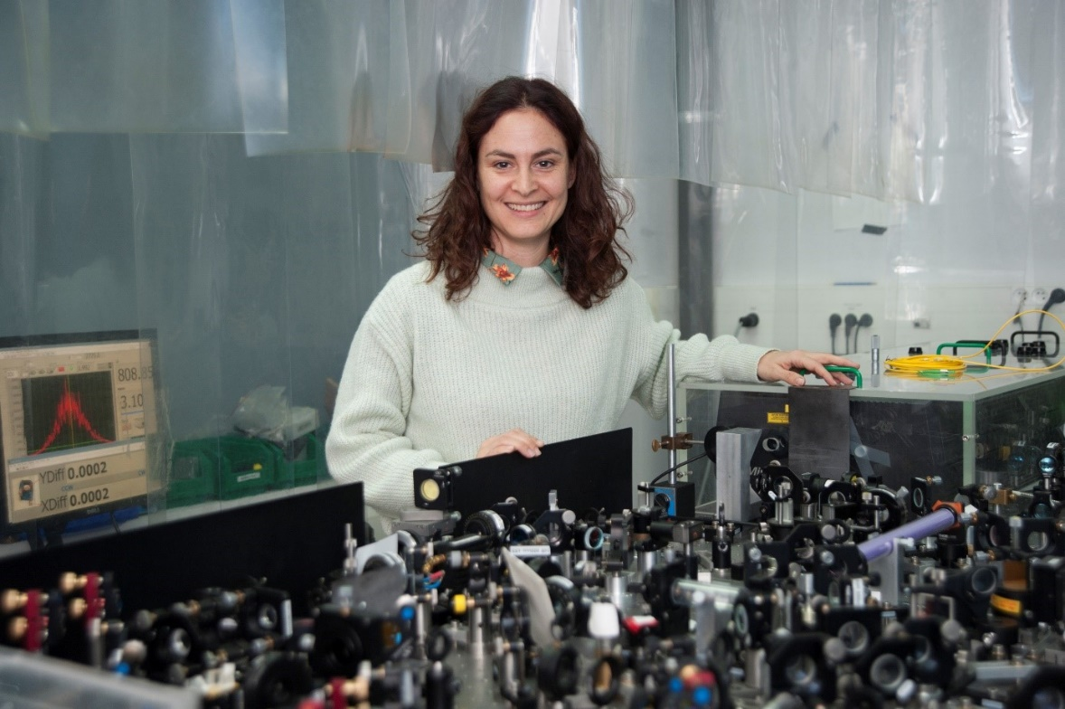
Where do Quantum Engineers fit in?
IBM Q Quantum Computer, 2019
SQCRAM quantum microscope, Benjamin Lev lab, Stanford
Valentina Parigi with all-optical complex quantum network, Sorbonne U., Paris
Walschaers, Treps, Sundar, Carr, and Parigi, Emergent complex quantum networks in
continuous-variables non-Gaussian states, PRX Quantum under review, arXiv:2012.15608 (2020)
Notes:
Scanning Quantum Cryogenic Atom Microscope

Slide 7
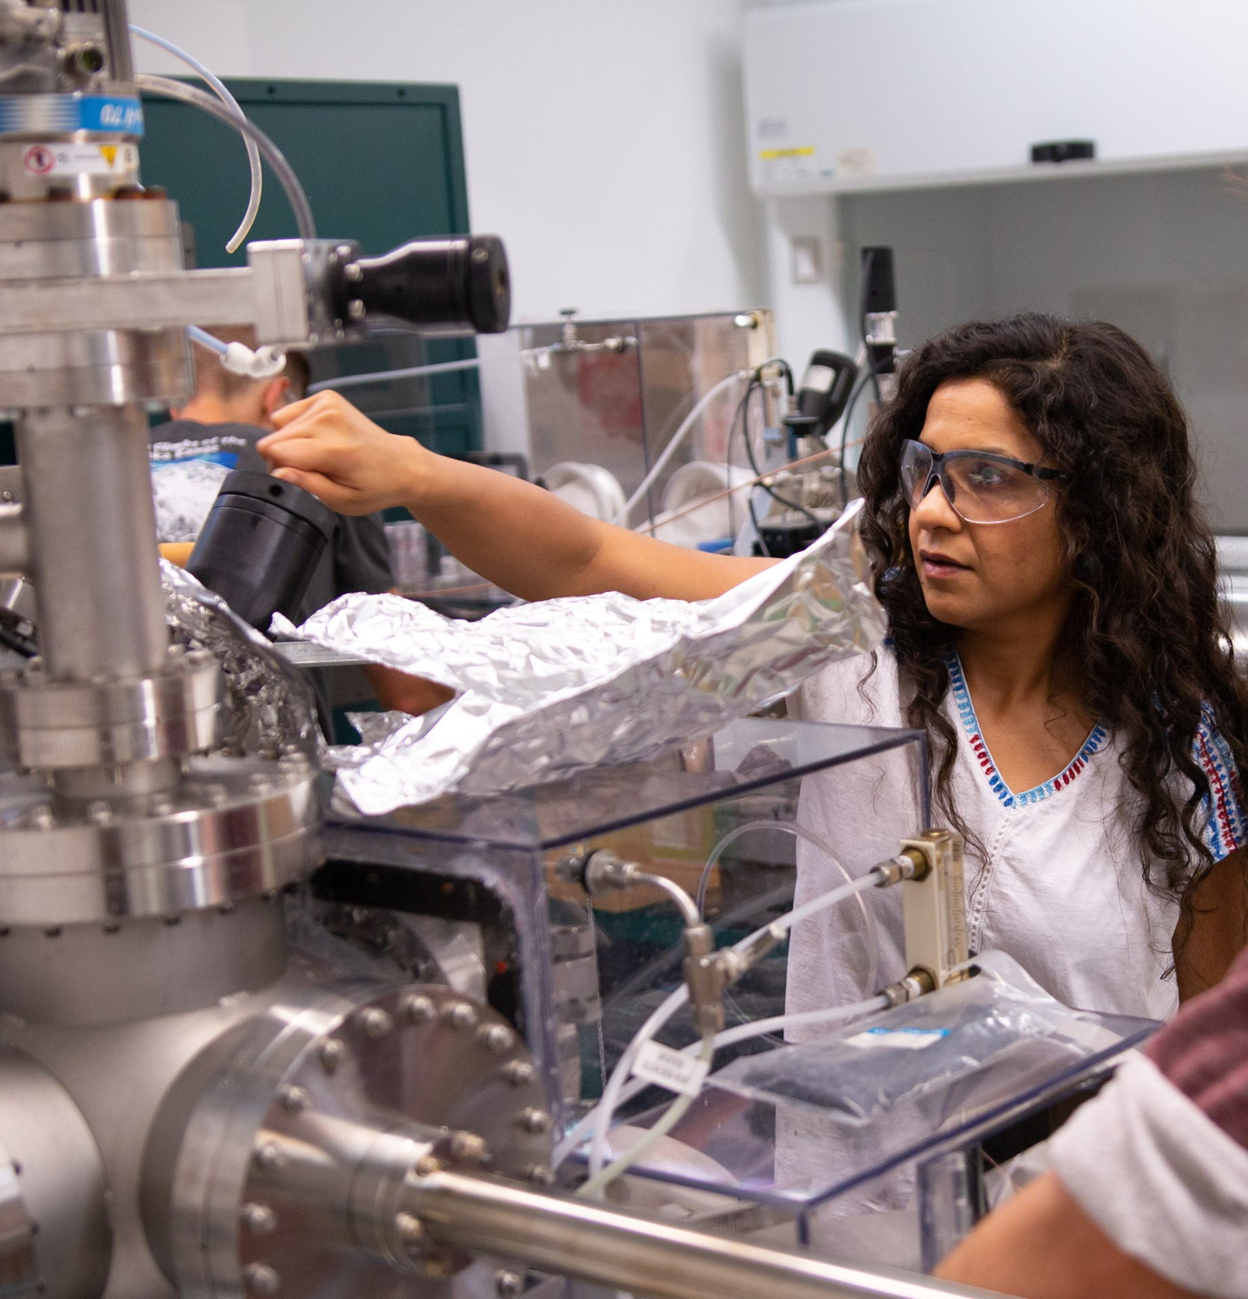
Quantum Engineering at Mines
Software/Hardware tracks
  Programming on actual quantum computers
  Hands-on training facilities
    Computing: Low temp. superconducting qubits
    Communications: Quantum optics
    Sensing: Nitrogen vacancy center microscopy
Thesis/Non-Thesis Master’s, Undergrad Minor
All-STEM-accessible quantum courses
20 faculty from 6 departments
NSF Research Traineeship (NRT) program, joint with San Jose State U.
Network with 4 National Labs
https://quantum.mines.edu/

Slide 8
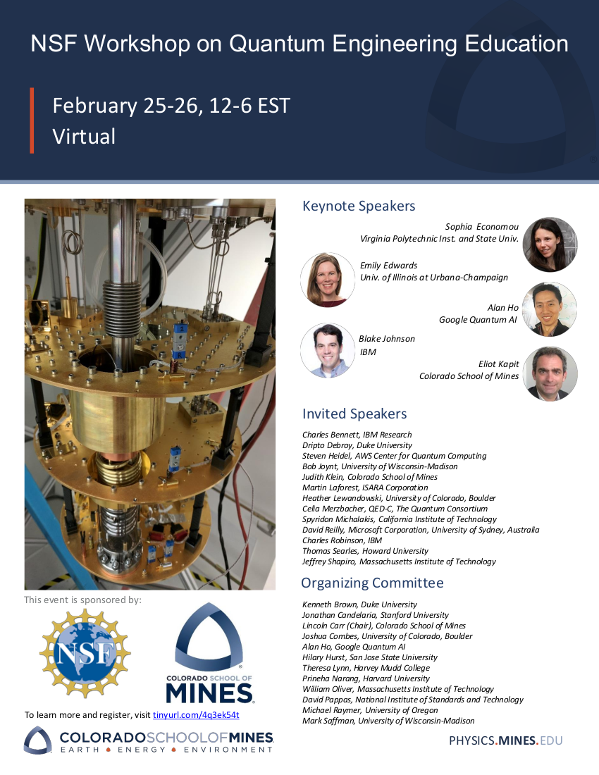
Quantum Engineering in the US?
Hosted by OSA: tinyurl.com/4q3ek54t
Quantum Engineering Education Roadmap → IEEE Transactions on Education
  https://arxiv.org/abs/2108.01311

Slide 9
Quantum Engineering
The application of engineering methods and principles to quantum information systems and problems
  Quantum-aware vs. quantum-proficient engineers
  Quantum Information Science and Engineering (QISE)

Slide 10

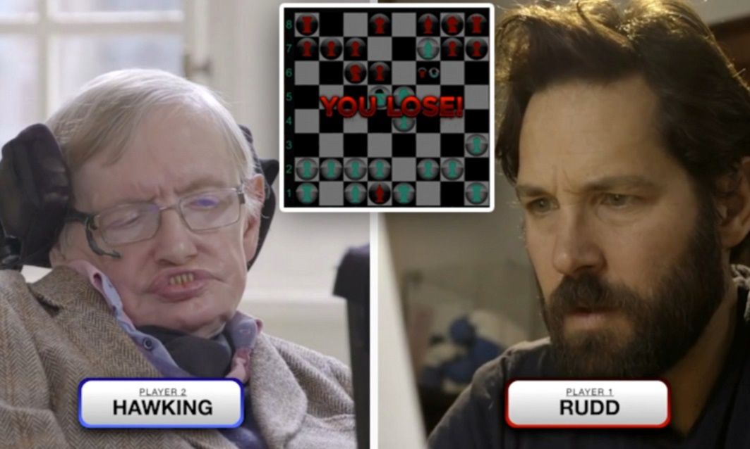
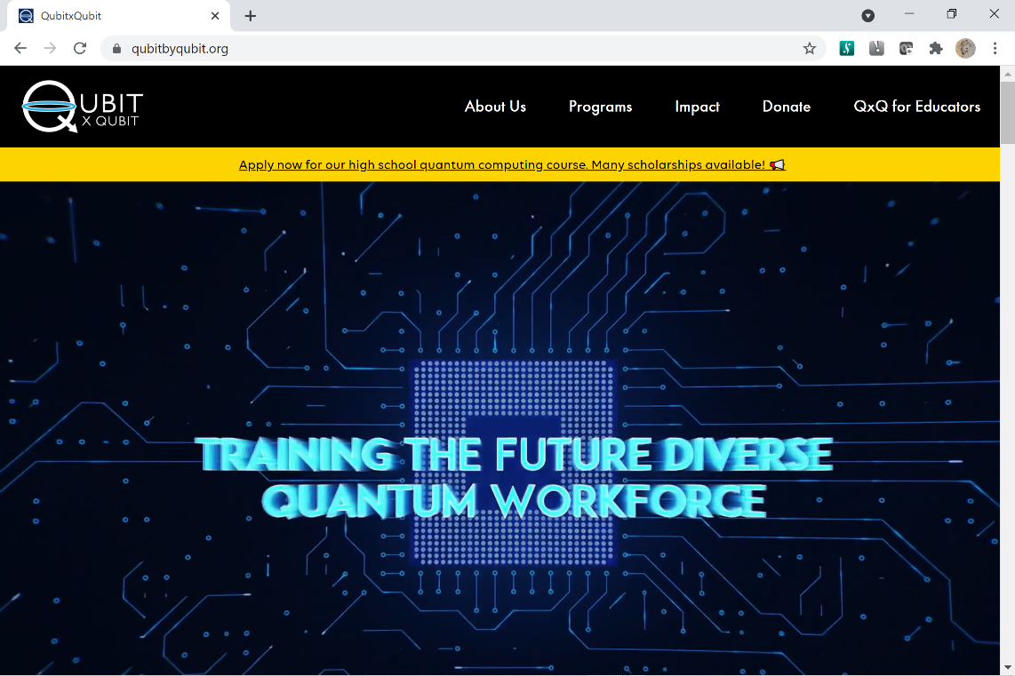
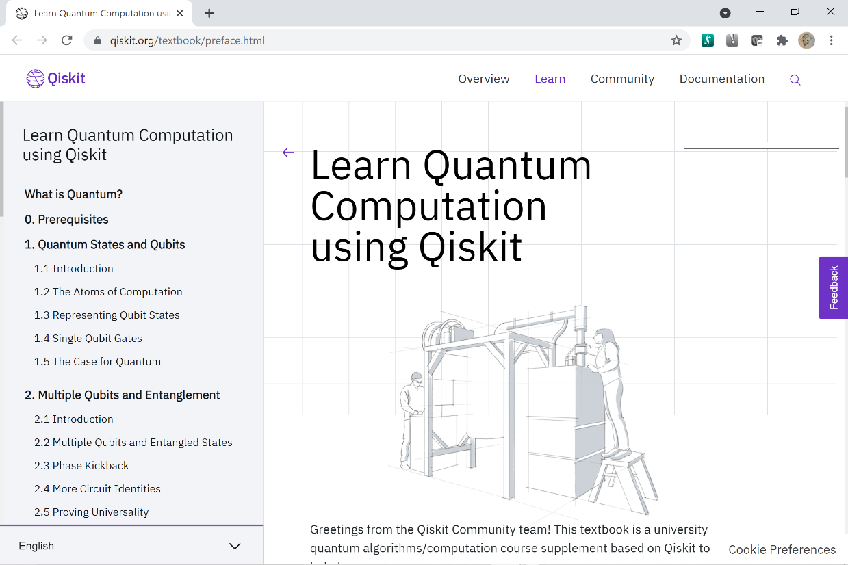
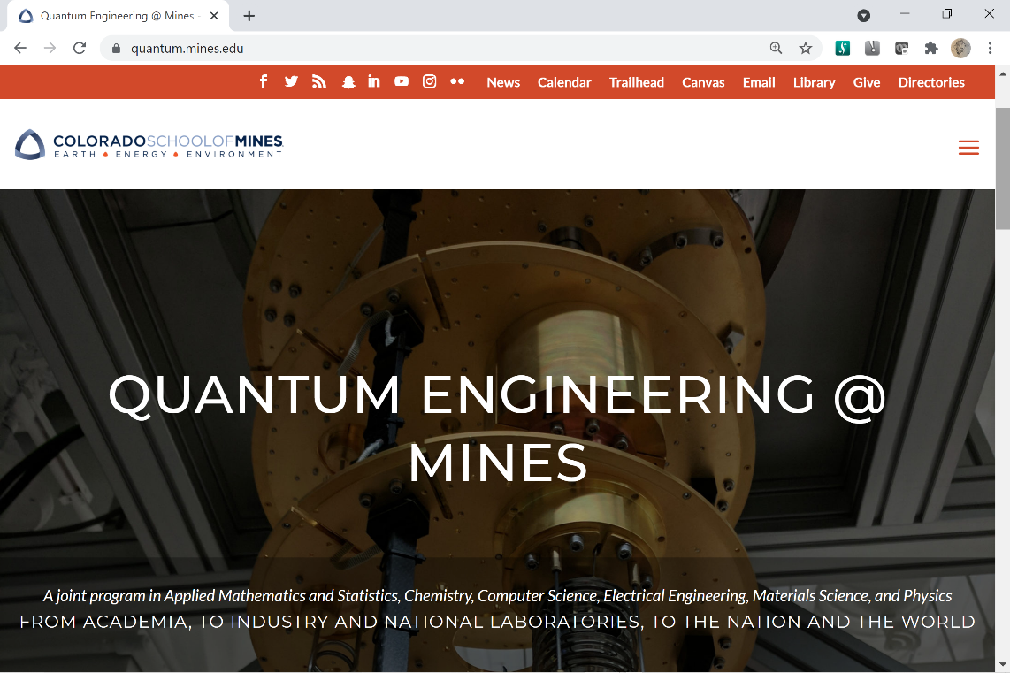
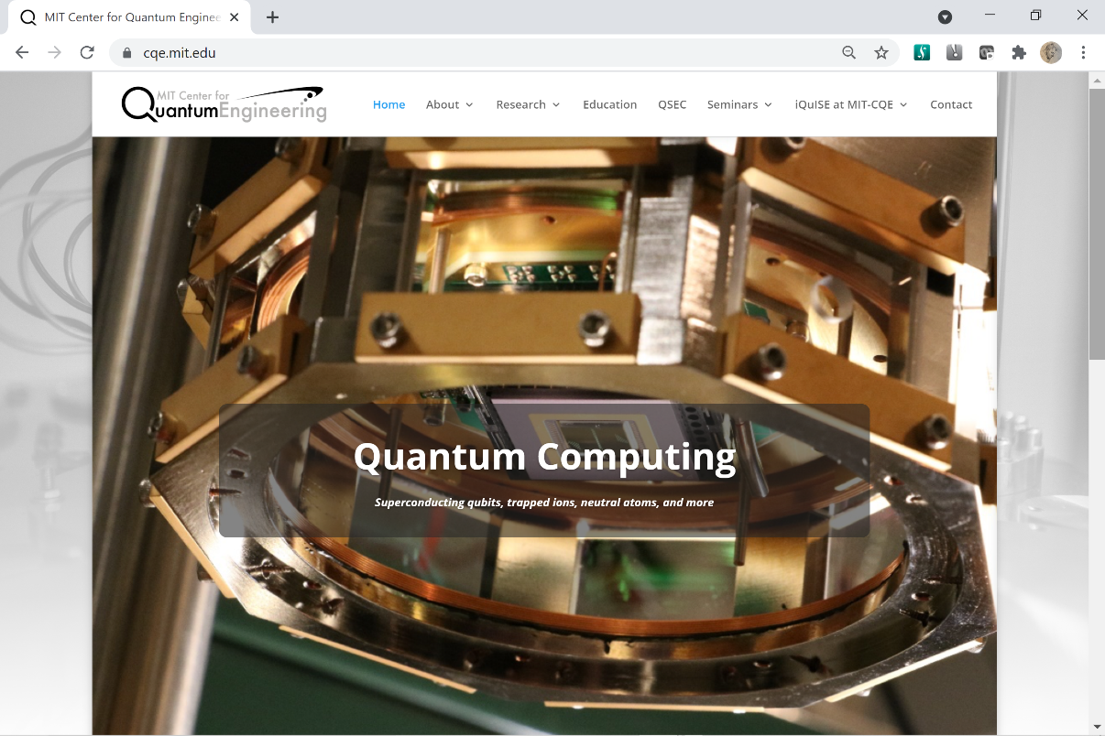
Quantum Educational Gap
Quantum Inspiration
High school and Upskilling
Quantum Experts: PhD and MS
What about undergraduates?

Slide 11
Creating the Quantum Aware Engineer
First course in modules
  Balance Computing, Communications, Sensing
  Four-year colleges and teaching-focused universities, research universities
Quantum engineering education research
  Learning goals: Adapt 9 Key Concepts for QIS to QISE
Enhance diversity
  Early research opportunities
  Applications up front

Slide 12
First Quantum Course for STEM students
Blais: 2-3-7-4-6-11
Carr: 0-1-2-3-8-10
Economou: 1-2-3-7-4-6, then 8-9-10-11
Girvin: 1-2-3-4-6
Kapit: 2-3-8-9-10-4
Lynn: 2-3-11-4-6-7
0: Linear Algebra
1: Classical information theory
2: One and two quantum bits
3: Two-qubit gates and entanglement
4: Quantum algorithms
5: NISQ devices and algorithms
6: Quantum error correction
7: Quantum communication and encryption
8: Hamiltonians and time evolution
9: Dynamics with time-varying Hamiltonians
10: Open quantum systems
11: Physical quantum bits
12: Quantum sensing modalities

Slide 13
Quantum 101
A “freshman” course for all majors, including non-STEM
Quantum for Everyone
  Community colleges and military schools
    High school students taking community college classes
  Continuing Education
  General college student beyond Marvel films
  Accessible 1st step in any university
    Teaching or research focused
Proof concepts (math), programming concepts (CS)
Focus on concepts, applications, intuition
  Q is for Quantum, Terry Rudolph
  Economou, Rudolph, and Barnes, “Teaching quantum information science to high-school and early undergraduate students”, arXiv:2005.07874
  (Carr: humanities honors courses at Mines, Pathways to Innovation)
Notes:
Anecdote about my mom at Vanderbilt

Slide 14
Creating the quantum proficient engineer
Challenges (many)
  Rapidly changing technological landscape
  T-shaped engineer
  Led by engineering departments
Breadth of quantum technologies
  Atoms and ions
  Semiconductors, superconductors,
  Integrated optics, nanofabrication
  Microwave and RF control and readout
  …
Areas of specialization
  Quantum sensing and devices
    most advanced, least taught!
  Quantum communications and cryptography
  Quantum simulations and computing

Slide 15
Quantum Engineering Minor
Typically 6-7 courses, 3 core
Only requires 3-4 new/adapted courses
Rest leveraged from standard engineering list
Biggest barrier hands-on training
Engineering principles and design in QISE context – ABET
Three working examples

Slide 16
Case 1: QE Minor at Colorado School of Mines
6 departments, 6 courses
Linear algebra
3 of the following:
  (i) Fundamentals of quantum information
  (ii) Quantum programming
  (iii) Low temperature microwave measurement
  (iv) Quantum many-body physics
  (v) Microelectronics processing
Final 2 from full QE course list e.g.
  Feedback control systems
  Digital signal processing
  Semiconductor device physics and design
  Computational materials, and machine learning
Required creation of 4 new courses (i)-(iv) targeted at quantum engineers and general STEM students

Slide 17
Case 2: QE Minor at University of Colorado Boulder
Requires 6 courses with 3 pre-reqs
  (programming, calculus, and linear algebra)
3 of the following:
  (i) Foundations of quantum engineering, or 2 semesters upper division QM in Physics Dept
  (ii) Foundations of quantum hardware
  (iiia) Introduction to quantum computing (theory track), or (iiib) quantum engineering lab (experimental track)
Remaining 3 from extant engineering courses, e.g.
  Microwave and RF laboratory
  Control systems analysis
  Machine learning
  Solid state physics
Required creation of 4 new courses, (i)-(iiia-b)

Slide 18
Case 3: QE Minor at Virginia Tech
7 departments across Science and Engineering colleges
Requires 8 courses, 6 of them mandatory:
  (i) Linear algebra (pre-req for CU Boulder)
  (ii) Quantum 101 (concepts)
  (iii) Quantum for STEM majors
  (iv)-(v) 2 semesters: Classical programming. quantum programming, and collaborative software
  (vi) Physical quantum platforms or advanced quantum computing
Remaining 2 from extant engineering catalog
Required creation of (ii) and (iv)-(v)

Slide 19
Quantum engineering track within engineering majors
Can more closely specialize and integrate directly with major
  e.g. EE or CS-based quantum software, hardware, and algorithms tracks
Suggest 4 required courses:
  Quantum Engineering I-II
    Draws on Modular First Quantum Course for STEM majors
  Hands-on Training with Quantum Hardware I-II
    At least two different technologies
Suggest 2 optional courses drawn from extant engineering offerings e.g.:
  Nanofabrication
  Materials science
  Solid state devices
  Machine learning
Recommend Quantum 101 to help recruit
Extant example at U. Chicago
  Molecular engineering, quantum track

Slide 20
Diversity Opportunity
Quantum workforce reflects present STEM workforce
Low # of graduates from educationally marginalized
  racial and ethnic groups,
  sexual preferences,
  and genders, including women (largest group)
How to build diverse, equitable, and inclusive quantum engineering undergraduate programs?
Concrete recommendations in 3 areas:
  (i) Climate
  (ii) Curriculum and program evaluation
  (iii) Industry

Slide 21
Diversity Recommendations
Climate
  Research mentor training in best practices
    Building authenticity and trust
    Engaging in culturally aware communications
  Periodic climate surveys of students made publicly available
  Early, high-quality, multi-semester research experiences
Curriculum and program evaluation
  Transfer pathways from community colleges
    Quantum 101
  Disaggregate data on outcomes by gender and race/ethnicity
  Brief early interventions in classroom on inclusivity and equity
  Course and department goals focus on outcomes, not # of students
    Career outcomes
  Professional development
    Writing and culturally aware communication skills
Industry
  Equitable access to industry educational resources and internships
  Formal partnership with minority-serving programs, e.g. IBM-HBCU
  Credentialing pathways for marginalized students through internships and/or open-source educational materials

Slide 22
Hands-on training on quantum hardware
Highly diverse skill sets
  E.g. quantum optics labs vs. microwave-controlled superconducting quantum circuits
QISE links disparate technologies with a common language
  Link must be physical – theory is not enough
Solutions institution-dependent
  budgets, faculty expertise
  Recommend cross-institution exchange of expertise
  Partnership with national labs, quantum centers
Core skills
  Preparation, measurement, and control of quantum states
  Multi-platform knowledge → technological versatility

Slide 23
Present Key Areas of Technology
(rapidly evolving)
Optics
  Budget-friendly, e.g. parametric down conversion in ready-made kits ~$20K USD
  Many demonstrations, see Quantum mechanics: theory and experiment, Mark Beck (2012, OUP)
  Implemented in smaller four-year colleges already
Atoms and Ions
  Individual fundamental quanta
  Nitrogen vacancy centers – quantum sensing
  Optical pumping, laser cooling
  Cloud access to remote machines at IonQ
Cyrogenic and Solid State
  ~$300K entry-level cost for dilution fridge
    Local expertise or grouping across regional schools
  Alternates: Superconductors, pulsed NMR

Slide 24
Key technologies already available in engineering programs and industry
Nanofabrication – already in materials engineering etc.
  Photonic or superconducting quantum computing, spin qubits, ion traps
  National labs, regional centers, larger universities
Quantum-classical interface – draws on EE courses
  data converters, amplifiers, signal sources, and digital logic for waveform control
  cabling, packaging, optical fibres, chip-interconnects, resonators, and on-chip routing and multiplexing
  Need lab courses with microwave engineering, programming of embedded systems, signal generators, digitizers, and related hardware
Industry contributions
  Quantum software: Qiskit, Cirq, Katas
  Remote operation of quantum computing hardware: AWS, Google, IBM, IonQ, and Rigetti
  Extensive online tutorials, undergrad internships

Slide 25
Summary and Key Recommendations for a quantum engineering roadmap
New quantum programs in engineering departments
  Supported by science and math
Quantum-aware engineers
  Modular course offered
  One course is enough!
Quantum-proficient engineers
  Minors/Tracks
  Only 3-4 new courses to get off the ground
  Three current examples: Mines, CU Boulder, VA Tech
Quantum 101: Concepts-based course
  Community colleges, military schools, high schools, recruiting tool
Hands-on training on quantum hardware
  At least 2 platforms
  Affordable via partnership with regional and quantum centers
Growth opportunities
  Quantum engineering education research
  Diversity, equity, and inclusion
    Periodic climate surveys made publicly available
    Focus on outcomes in classes, degrees, and careers, not just # of students
https://arxiv.org/abs/2108.01311

Slide 26
9 Key Concepts for QIS
→ https://qis-learners.research.illinois.edu/
Quantum information science (QIS) exploits quantum principles to transform how information is acquired, encoded, manipulated, and applied. Quantum information science encompasses quantum computing, quantum communication, and quantum sensing, and spurs other advances in science and technology.
A quantum state is a mathematical representation of a physical system, such as an atom, and provides the basis for processing quantum information.
Quantum applications are designed to carefully manipulate fragile quantum systems without observation to increase the probability that the final measurement will provide the intended result.
The quantum bit, or qubit, is the fundamental unit of quantum information, and is encoded in a physical system, such as polarization states of light, energy states of an atom, or spin states of an electron.
Entanglement, an inseparable relationship between multiple qubits, is a key property of quantum systems necessary for obtaining a quantum advantage in most QIS applications.
For quantum information applications to be successfully completed, fragile quantum states must be preserved, or kept coherent.
Quantum computers, which use qubits and quantum operations, will solve certain complex computational problems more efficiently than classical computers.
Quantum communication uses entanglement or a transmission channel, such as optical fiber, to transfer quantum information between different locations.
Quantum sensing uses quantum states to detect and measure physical properties with the highest precision allowed by quantum mechanics.

